Slide 1
Artificial Intelligence for Games Week 5 – Pathfinding 3 Steve Rabin
For help on projects, email everyone (select and copy this string from the start of any class PowerPoint):
steve.rabin@gmail.com, p.jiankai@digipen.edu, b.hsu@digipen.edu, zak.s@digipen.edu, keaton.sullivan@digipen.edu, john.tseng@digipen.edu, a.roulst@digipen.edu
TAs: Jian Kai Phua, Brandon Hsu, Zak Stephenson, Keaton Sullivan, John Tseng, Andrew Roulst

Slide 2
Questions
If a pathfinding search algorithm is “complete”, then what does it guarantee?
Which search algorithms are “smart”?
A heuristic estimate is a guess of what?
Why do we care that a heuristic is admissible?
What does it mean for a heuristic to be admissible?
A* is a combination of which two search algorithms?

Slide 3
Project 2: How to get started (if you are frozen)
Make the search space representation:
Define the Node structure (next slide).
Pre-allocate at boot time (statically) the max map of 40x40 nodes (just make a 2D array).
Make a function to clear these nodes (call this function before each search).
Make the Open list that holds pointers to the nodes (do not have it hold actual Node structs!). Remember the Open list needs to support Pop (cheapest node), Push (node), Update (node). If you are uncertain, implement the simple unsorted Open list as described in class (coming up). Later you can make it faster by implementing the Bucket version (coming up).
A* algorithm:
Sketch out the A* algorithm using the pseudocode. Just copy the text from PowerPoint and comment out each line.
Fill out the comments with real code.

Slide 4
Grid Search Space: Node Structure
Node* parent; // Parent
GridPos gridPos; // Node’s location
float finalCost; // Final cost f(x)
float givenCost; // Given cost g(x)
enum onList; // On open/closed list?
SMALLER DATA STRUCTURE = FASTER SEARCH

Slide 5
A* Algorithm
If (request.newRequest) {
Initialize everything. Clear Open/Closed Lists.
Push Start Node onto the Open List with cost of f(x) = g(x) + h(x).
}
While (Open List is not empty) {
parentNode = Pop cheapest node off Open List.
If parentNode is the Goal Node, then path found (return PathResult::COMPLETE).
Place parentNode on the Closed List.
For (all valid neighboring child nodes of parentNode) {
Compute its cost, f(x) = g(x) + h(x)
If child node isn’t on Open or Closed list, put it on Open List.
Else if child node is on Open or Closed List, AND this new one is cheaper,
then take the old expensive one off both lists and put this new
cheaper one on the Open List.
}
If taken too much time this frame (or if request.settings.singleStep == true),
abort search for now and resume next frame (return PathResult::PROCESSING).
}
Open List empty, thus no path possible (return PathResult::IMPOSSIBLE).

Slide 6
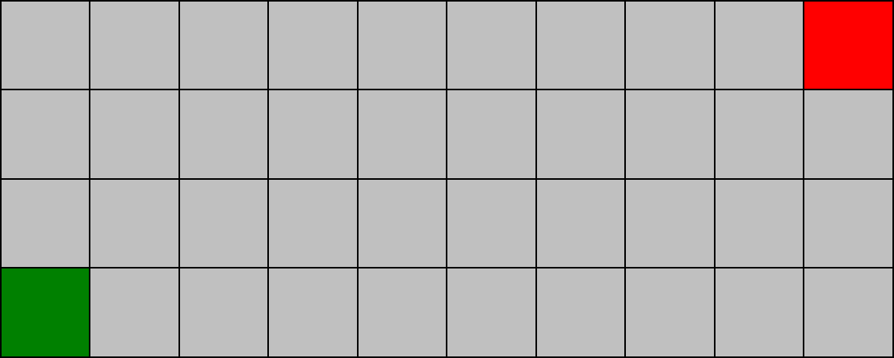
A
Diagonal
Diagonal Correctness:
Is the “Diagonal” a valid neighboring node of the parent node “P”?
When you are in the neighbor loop iterating through all the neighbors of “P”, for diagonals you need to check if the diagonal is not a wall and if the two nodes next to the diagonal are not walls (“A” and “B”)
?
B
P
For (all neighboring child nodes of parentNode) {
If (valid neighbor) {
Compute its cost, f(x) = g(x) + h(x)
Conditionally put it on the Open list
}
}

Slide 7
Additional Speed Tips
To clear the map, you only really need to set your “enum” to none. If the node is on neither list, then all of the other info is garbage. You could make a hot/cold list for this purpose – look that up. Maybe there is an even better way to mark that a node’s data is garbage/dirty.
The function sqrt(2) at runtime is expensive. Don’t do that.
If you have a bunch of conditionals for which heuristic to use, make sure Octile is the first one since that is what the Speed Test uses. A very smart implementation would ensure that you didn’t need to run a bunch of if tests for each heuristic calc.
There is a flag called “debugColoring” that is false when the Speed Test is run. Don’t color the terrain if “debugColoring” is false.
You’ll likely need to precompute the neighbors to get more speed. Storing the neighbors as vector of Node pointers is not ideal. Think about indirection and cache coherency.

Slide 8
Storing the precomputed neighbors as vector of Node pointers (inefficient because memory is SLOW)
Node
(somewhere in memory, requires 1 or 2 cache lines which are 64 bytes each)
8 bytes
std::vector<node*> neighbors;
8 bytes
8 bytes
8 bytes
8 bytes
8 bytes
Node
Node
Node
Node
Node

Slide 9
Storing the precomputed neighbors as a byte is efficient (computing information is FAST)
Node
Loop through bits (1=valid neighbor)
[1,1,1,1,1,0,0,0]
1 byte
byte neighbors;
N NE E SE S SW W NW
Node
Node
Node
Node
Node

Slide 10
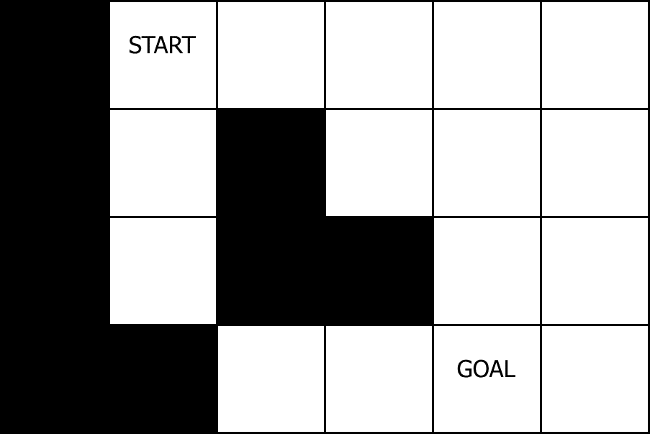
Diagonal Correctness

Slide 11
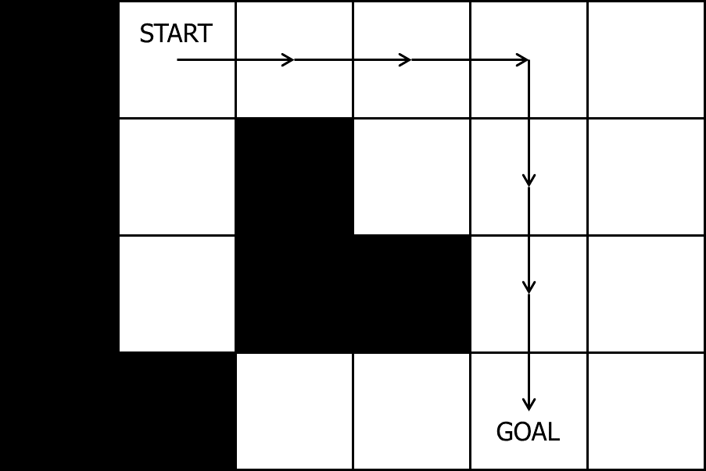
Diagonal Correctness: Wrong

Slide 12
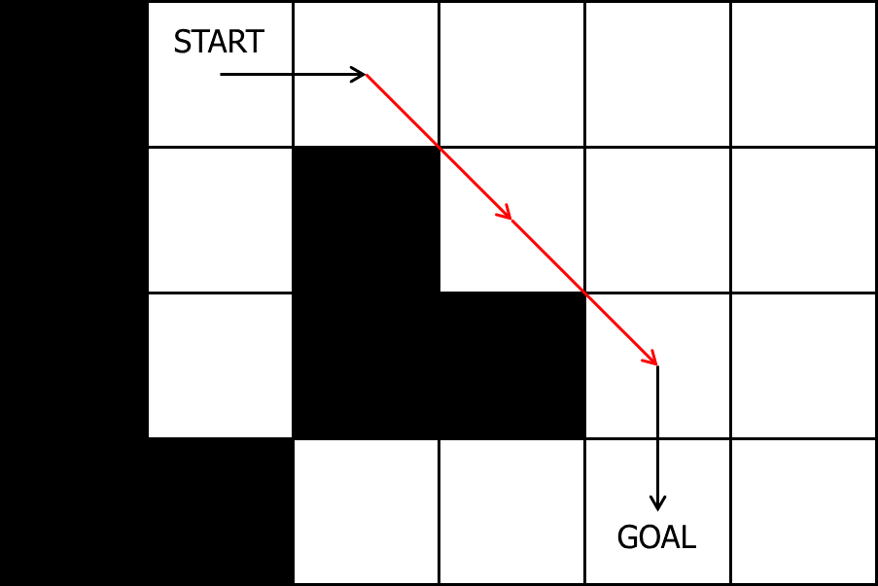
Diagonal Correctness: Wrong

Slide 13
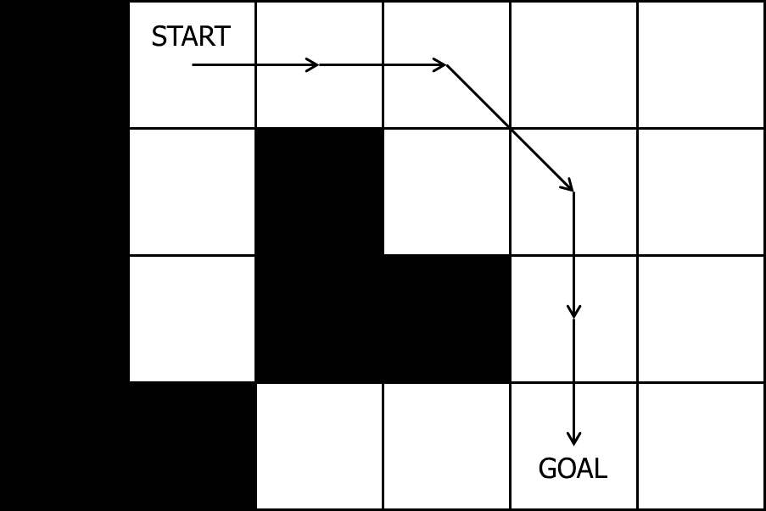
Diagonal Correctness: Correct

Slide 14
Grid Heuristic Calculations

Slide 15
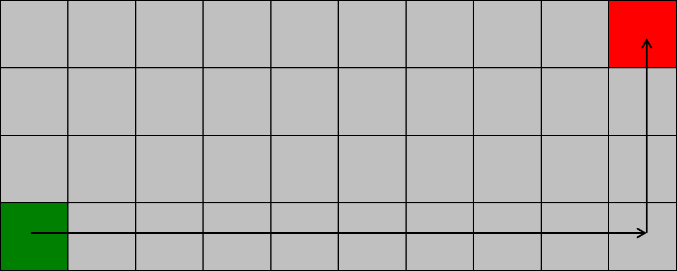
Manhattan distance
xDiff + yDiff = 9 + 3 = 12

Slide 16
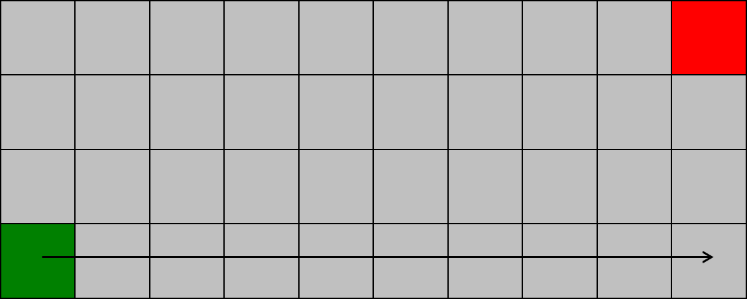
Chebyshev distance
max(xDiff, yDiff) = max(9, 3) = 9

Slide 17
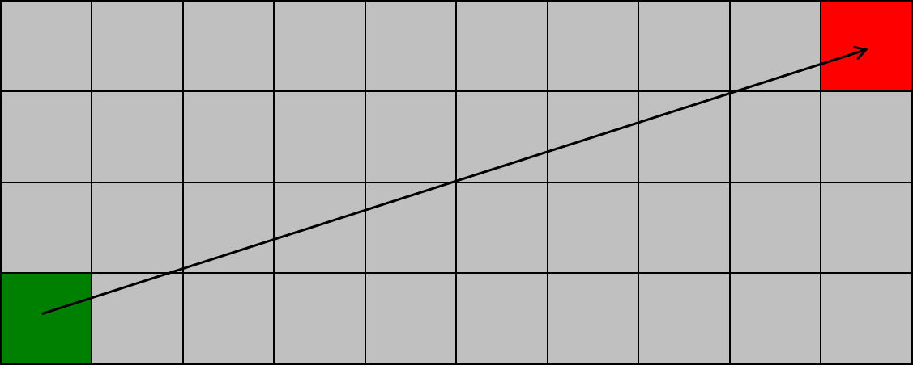
Euclidean distance
sqrt(xDiff² + yDiff²) = sqrt(9² + 3²) = 9.48

Slide 18
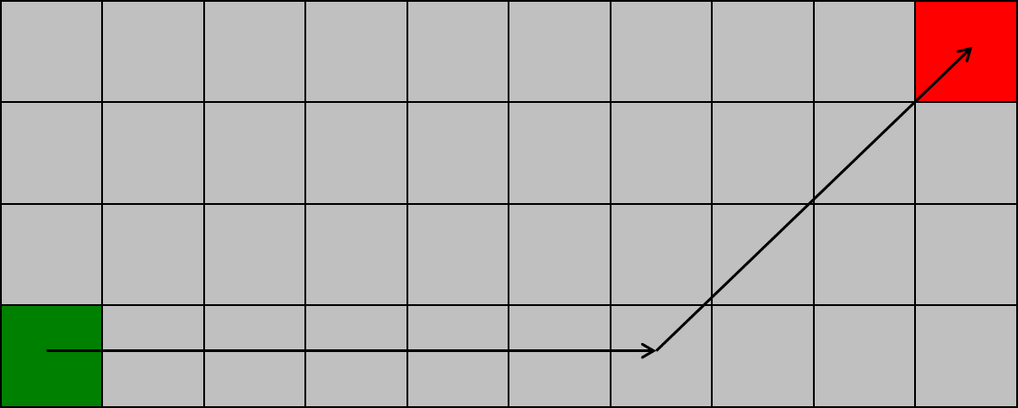
Octile distance
min(xDiff, yDiff) * sqrt(2) + max(xDiff, yDiff) – min(xDiff, yDiff)
min(9, 3) * 1.41 + max(9, 3) – min(9, 3) = 10.24

Slide 19
Which is Admissible? Which is Most Accurate?
Manhattan
Chebyshev
Euclidean
Octile

Slide 20
Which is Admissible? Which is Most Accurate?
Manhattan = 12
Chebyshev = 9
Euclidean = 9.48
Octile = 10.24

Slide 21
Inconsistent Heuristic Example
Use this code in your project for the inconsistent heuristic
C
To be consistent, a heuristic must obey the triangle inequality:
A → C ≤ A → B + B → A
Using the heuristic code to the right,
this code is an inconsistent heuristic:
(1,1)→(4,3) ≤ (1,1)→(2,1) + (2,1)→(4,3)
3.60 ≤ 1 + 0
3.60 ≤ 1
Does not obey the triangle inequality!
WARNING: An inconsistent heuristic results in some nodes on the Closed list having to go back on the Open list.
NOTE: An inconsistent heuristic still results in an optimal path.
3
2
if ((cur.row + cur.col) % 2 > 0)
{
return <Euclidean calculation>;
}
return 0;
A
B
1
1
2
3
4

Slide 22
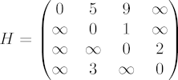
Roy-Floyd-Warshall All-Pairs Shortest Path
Pre-compute ALL paths
Just look up answer in a table!
1959 Bernard Roy
1962 Robert Floyd
1962 Stephen Warshall

Slide 23
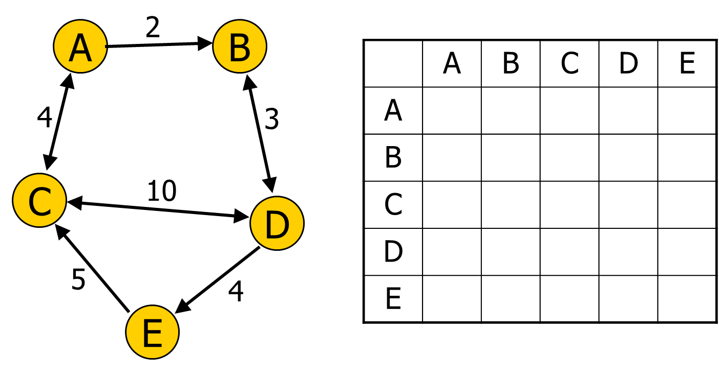
All-Pairs Shortest Path Table

Slide 24
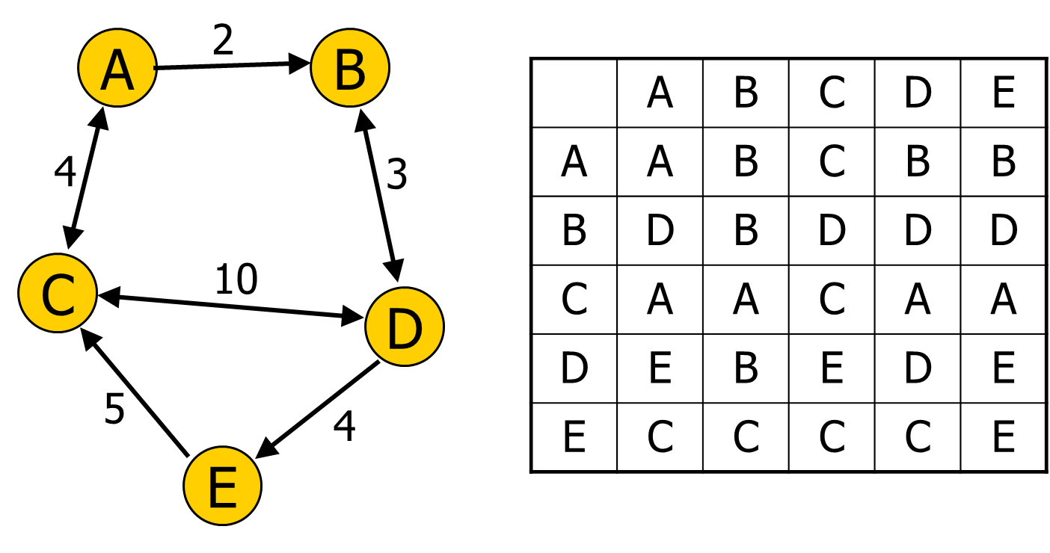
All-Pairs Shortest Path Table

Slide 25
int path[][]; //initialize to starting costs
void FloydWarshall()
{
for (k = 1 to n)
{
for each (i,j) in (1..n)
{
path[i][j] = min ( path[i][j],
path[i][k] + path[k][j] );
}
}
}

Slide 26
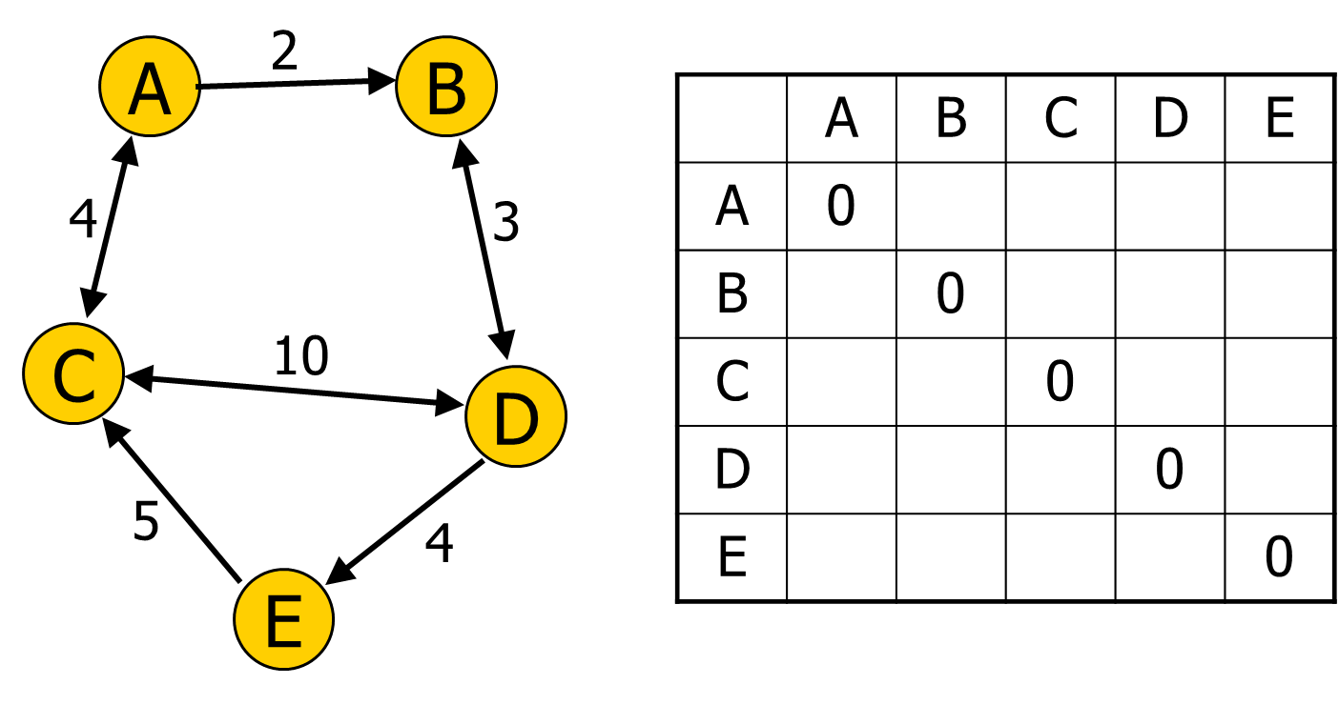
All-Pairs Shortest Path Table

Slide 27

All-Pairs Shortest Path Table

Slide 28

All-Pairs Shortest Path Table

Slide 29

All-Pairs Shortest Path Table

Slide 30
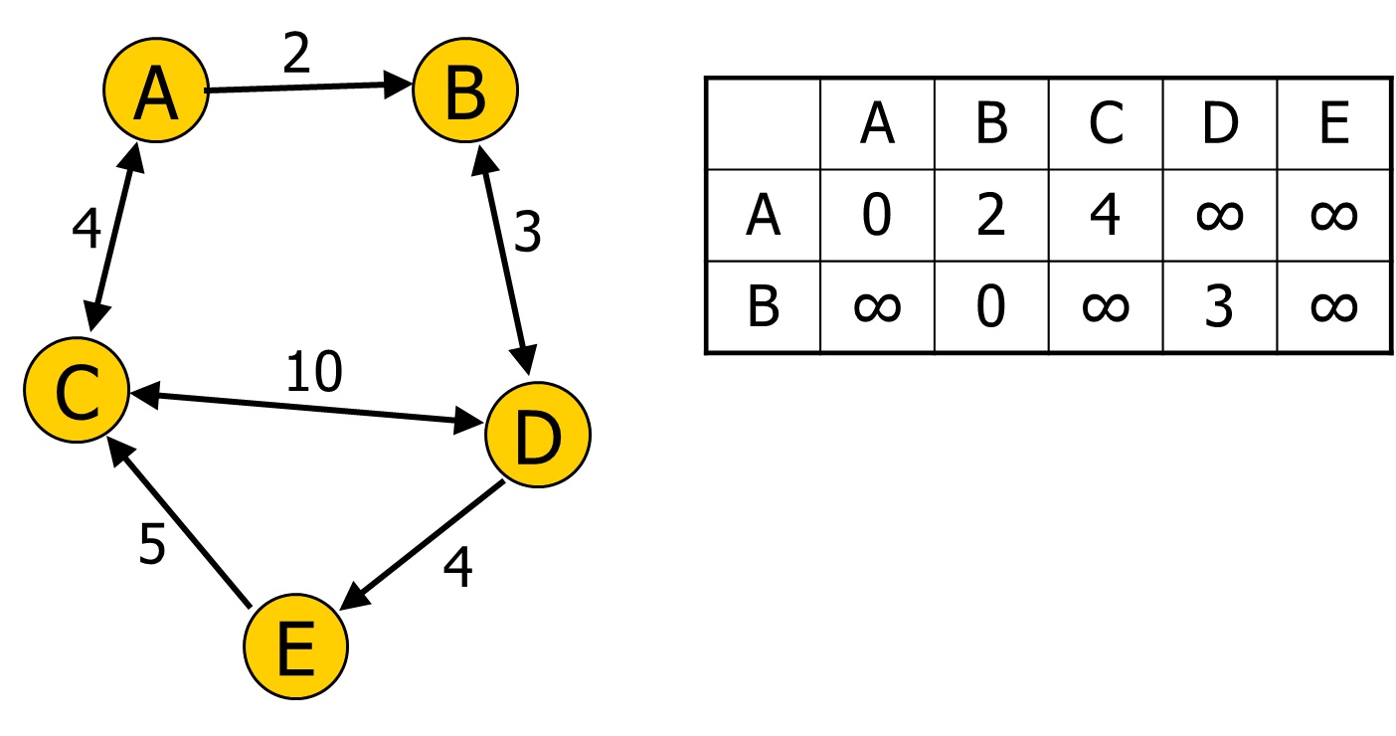
All-Pairs Shortest Path Table
for (k = 1 to n)
{
for each (i,j) in (1..n)
{
path[i][j] = min (path[i][j],
path[i][k] + path[k][j]);
}
}

Slide 31
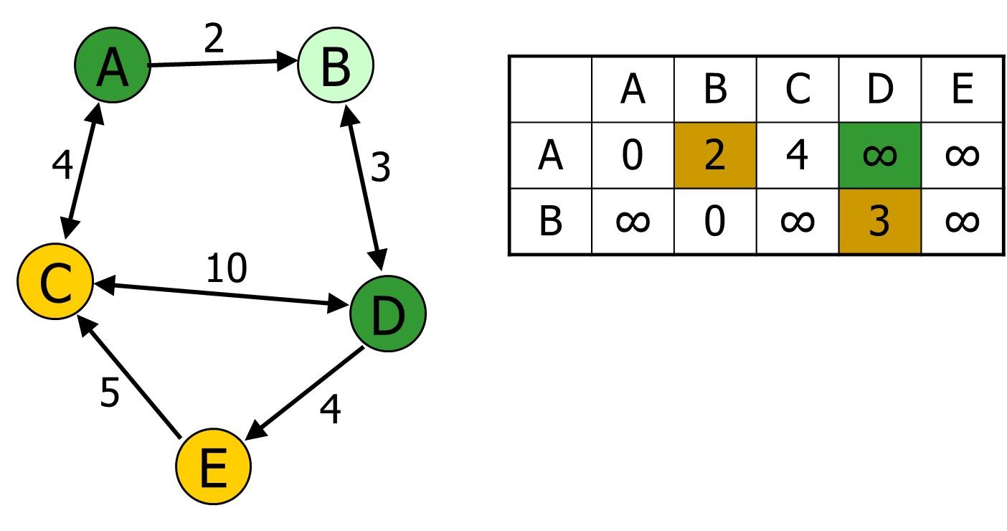
All-Pairs Shortest Path Table
for (k = 1 to n)
{
for each (i,j) in (1..n)
{ //example i=A, j=D, k=B
path[i][j] = min (path[i][j],
path[i][k] + path[k][j]);
}
}

Slide 32

All-Pairs Shortest Path Table
for (k = 1 to n)
{
for each (i,j) in (1..n)
{ //example i=A, j=D, k=B
path[i][j] = min (path[i][j],
path[i][k] + path[k][j]);
}
}

Slide 33

All-Pairs Shortest Path Table

Slide 34
All-Pairs Shortest Path Table

Slide 35
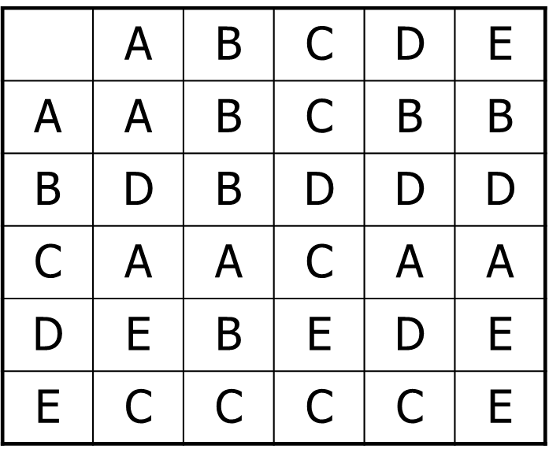
Roy-Floyd-Warshall All-Pairs Shortest Path
Speed of search?
Cost to compute?
What's the downside during runtime?
Which search space representations does it work on?

Slide 36
Overestimating the Heuristic Cost
A* combines Dijkstra and Best-First
Given cost and Heuristic cost
Final cost = Given cost + (Heuristic cost * weight)
f(x) = g(x) + (h(x) * weight)
Demo

Slide 37
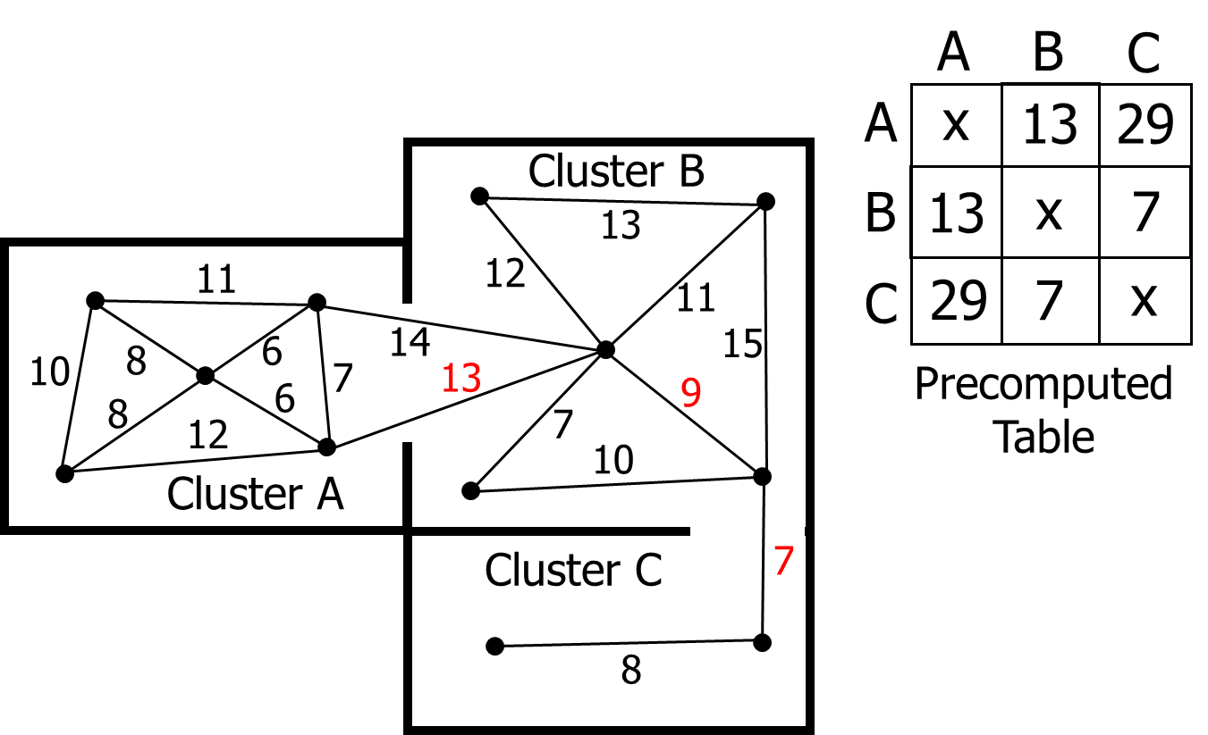
Cluster Heuristic

Slide 38
Two ways to sort the open list
Unsorted List
Pop: O(n) Brute force search for cheapest
Push: O(1) Trivial to push
Update: O(0) No work needed – List is not sorted
Priority Queue (binary tree)
Pop: O(log n)
Push: O(log n)
Update: O(n) Note: Typical P-Queues don’t have this

Slide 39

Unordered List Fast Array

Slide 40
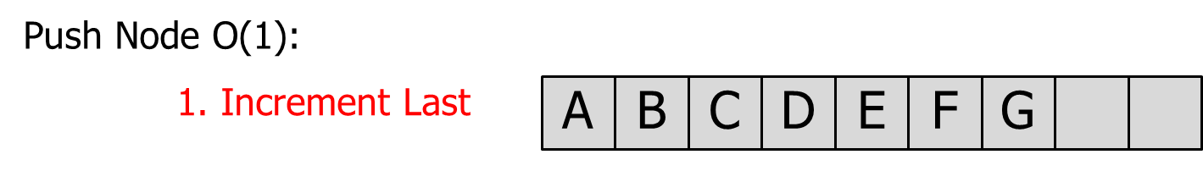
Unordered List Fast Array

Slide 41
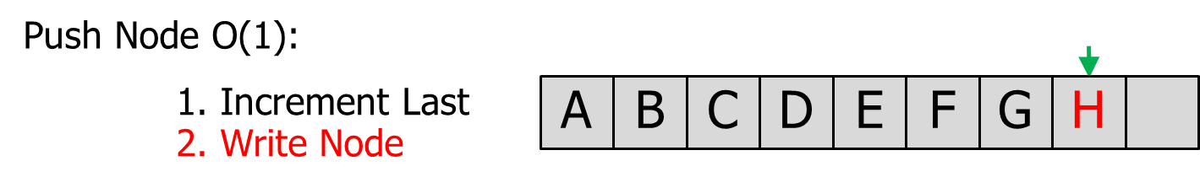
Unordered List Fast Array

Slide 42
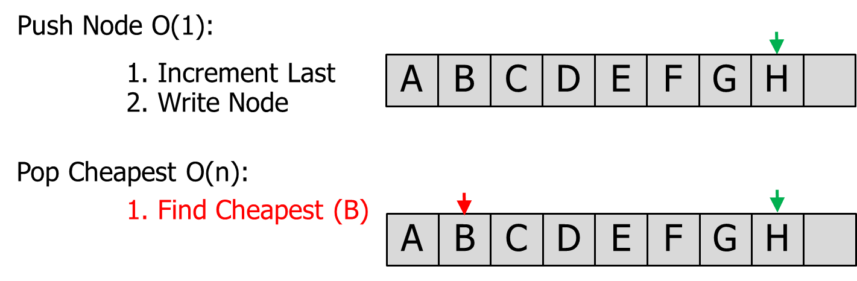
Unordered List Fast Array

Slide 43
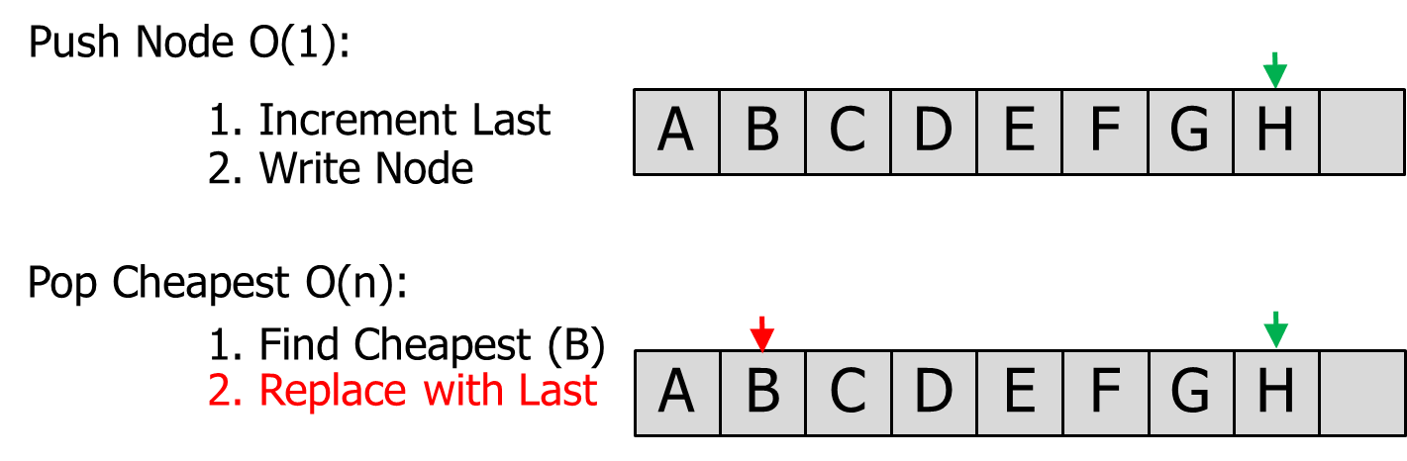
Unordered List Fast Array

Slide 44

Unordered List Fast Array
H

Slide 45
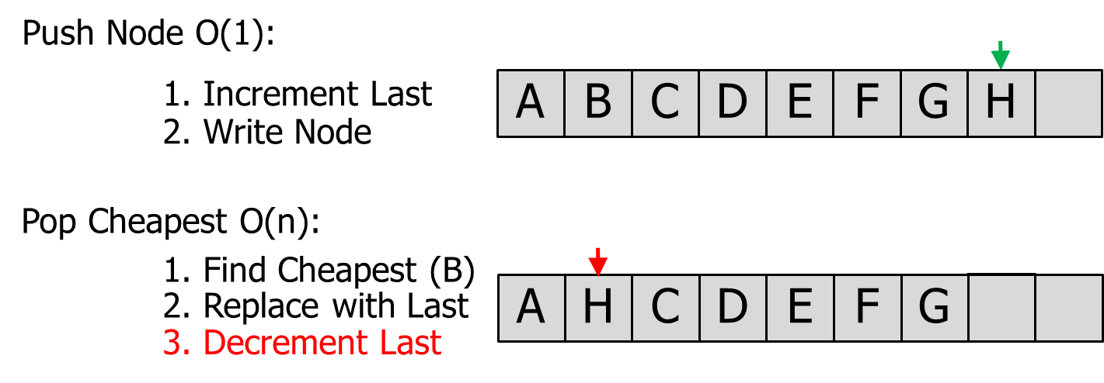
Unordered List Fast Array

Slide 46
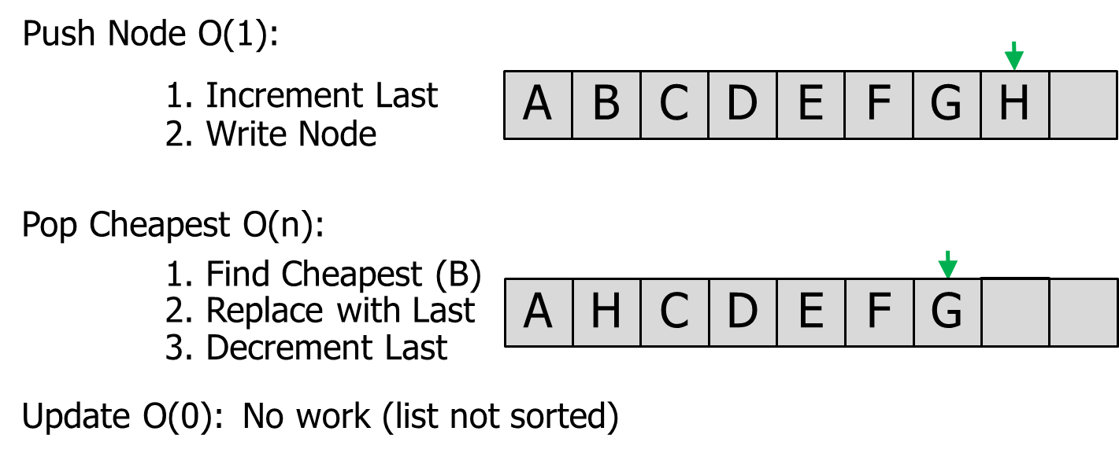
Unordered List Fast Array

Slide 47
Faster heap implementation
Generic Heap (Nathan Sturtevant)
Pop: O(log n)
Push: O(log n)
Update: O(1) Note: Uses a hash table
(function name is DecreaseKey)

Slide 48
Bucket Open List (fastest)
f(x)
Notes:
The size of each bucket should be tuned. Size of 1.0 is likely too big.
You need to choose a data structure to hold nodes inside each bucket (like Unsorted Array or Priority Queue).
Update the pointer to the lowest bucket when you Pop a node (move it upward until you find a bucket with nodes).
If you Push a node into a bucket lower than the current Pointer, move the Pointer to that lower bucket.
Bucket Open List is not used in games:
Might waste too much memory.
People might not know about this trick/technique.
7 to 8
6 to 7
This is just a pointer to a single pre-allocated node in the 40x40 array. Therefore, this f(x) cost is actually located in the Node struct. (Performance question: How does this affect cache coherency?)
5 to 6
5.7
4 to 5
4.1
3 to 4
Pointer to lowest bucket with nodes
(update this pointer as nodes are pushed or popped)
2 to 3
2.2
2.8
2.1
You need to figure out the best structure in each bucket. Recommendation: Start with an unordered list and see if you can improve from there.
1 to 2
0 to 1

Slide 49
Pathfinding Aesthetics

Slide 50
Pathfinding Aesthetics
We want to maximize responsiveness
How?
Don’t start moving until there is a path!
Stall for time:
Play an animation / sound clip until ready

Slide 51
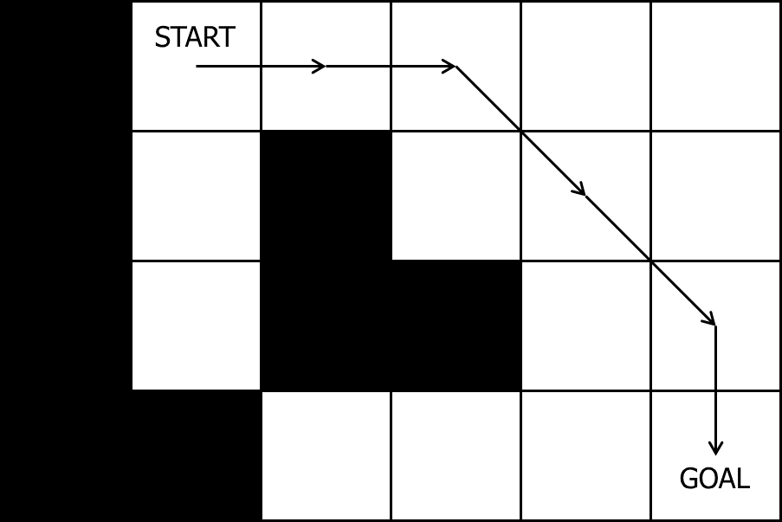
Post-Processing: Rubberbanding

Slide 52
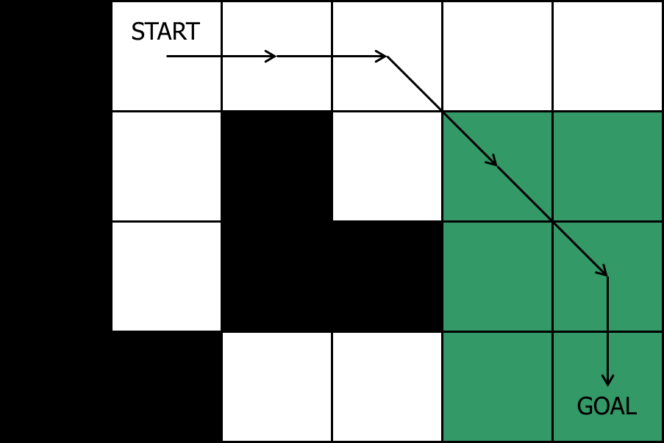
Rubberbanding: Can we eliminate the middle node?

Slide 53
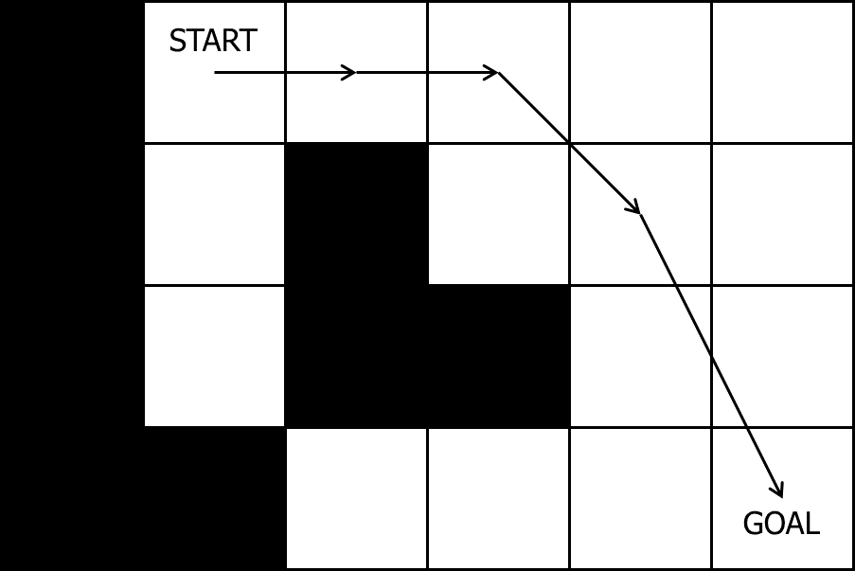
Rubberbanding: Middle node eliminated

Slide 54
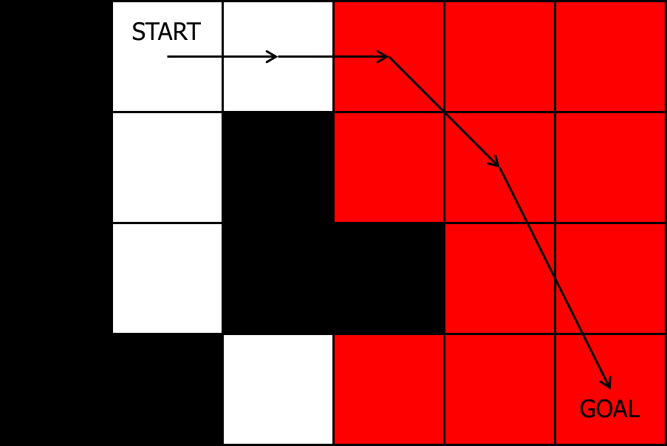
Rubberbanding: Can we eliminate the middle node?

Slide 55
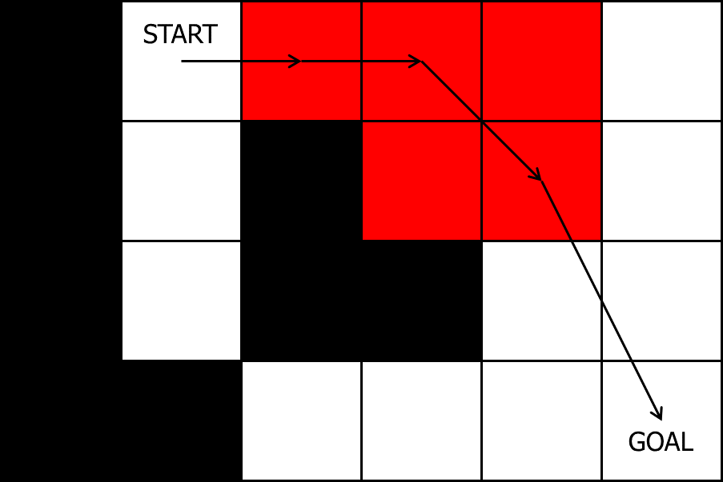
Rubberbanding: Can we eliminate the middle node?

Slide 56
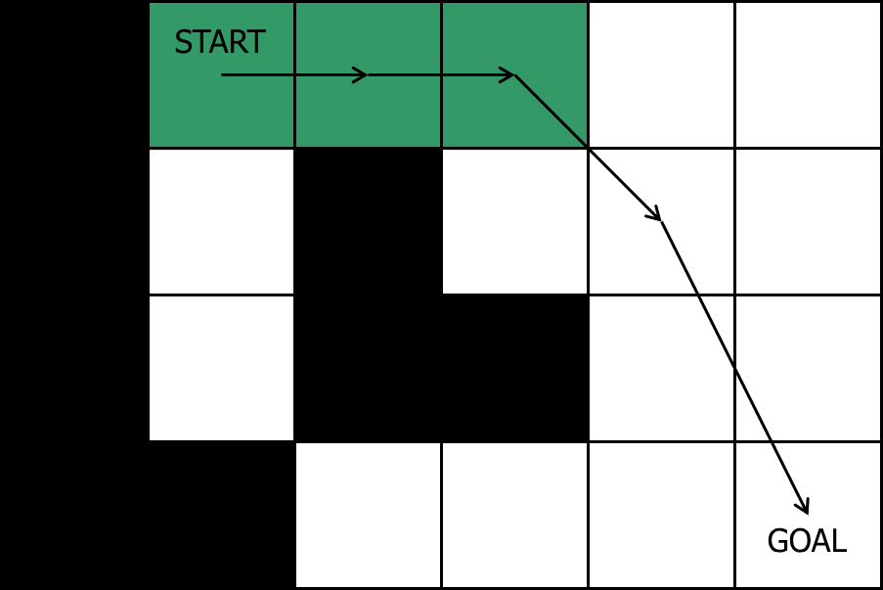
Rubberbanding: Can we eliminate the middle node?

Slide 57

Rubberbanding: Final path

Slide 58
Post-Processing: Smoothed Paths
Physics-based
At movement time – problems?
On waypoints before movement (demo)
Splines
Bezier Spline
Catmull-Rom Spline

Slide 59
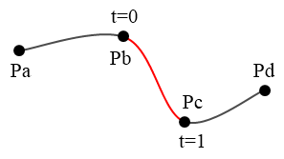
Catmull-Rom Spline
C1 continuity (not C2)
Passes through all control points

Slide 60
Catmull-Rom Spline
output_point =
point_1 * (-0.5*s*s*s + s*s – 0.5*s) +
point_2 * (1.5*s*s*s + -2.5*s*s + 1.0) +
point_3 * (-1.5*s*s*s + 2.0*s*s + 0.5*s) +
point_4 * (0.5*s*s*s – 0.5*s*s);
In SimpleMath.h (note that s is now t):
static Vec3 Vec3::CatmullRom(
const Vec3& v1, (Double up)
const Vec3& v2,
const Vec3& v3,
const Vec3& v4,
float t);
output_point
at s = 0.5
2
3
1
4

Slide 61
Algorithm to add in spline points
CatmullRom(v1, v2, v3, v4, t)

Slide 62
Algorithm to add in spline points
CatmullRom(v1, v2, v3, v4, t)
p1, p2
p3
p4

Slide 63
Algorithm to add in spline points
CatmullRom(v1, v2, v3, v4, t)
s = 0.25
pOut
p1, p2
p3
p4

Slide 64
Algorithm to add in spline points
CatmullRom(v1, v2, v3, v4, t)
s = 0.5
pOut
p1, p2
p3
p4

Slide 65
Algorithm to add in spline points
CatmullRom(v1, v2, v3, v4, t)
s = 0.75
pOut
p1, p2
p3
p4

Slide 66
Algorithm to add in spline points
CatmullRom(v1, v2, v3, v4, t)
p4
p1
p2
p3

Slide 67
Algorithm to add in spline points
CatmullRom(v1, v2, v3, v4, t)
p4
s = 0.25
pOut
p1
p2
p3

Slide 68
Algorithm to add in spline points
CatmullRom(v1, v2, v3, v4, t)
p4
s = 0.5
pOut
p1
p2
p3

Slide 69
Algorithm to add in spline points
CatmullRom(v1, v2, v3, v4, t)
p4
s = 0.75
pOut
p1
p2
p3

Slide 70
Algorithm to add in spline points
CatmullRom(v1, v2, v3, v4, t)
p3
p4
p1
p2

Slide 71
Algorithm to add in spline points
CatmullRom(v1, v2, v3, v4, t)
p3
p4
s = 0.25
pOut
p1
p2

Slide 72
Algorithm to add in spline points
CatmullRom(v1, v2, v3, v4, t)
s = 0.5
pOut
p3
p4
p1
p2

Slide 73
Algorithm to add in spline points
CatmullRom(v1, v2, v3, v4, t)
s = 0.75
pOut
p3
p4
p1
p2

Slide 74
Algorithm to add in spline points
CatmullRom(v1, v2, v3, v4, t)
p2
p3
p4
p1

Slide 75
Algorithm to add in spline points
CatmullRom(v1, v2, v3, v4, t)
s = 0.25
pOut
p2
p3
p4
p1

Slide 76
Algorithm to add in spline points
CatmullRom(v1, v2, v3, v4, t)
s = 0.5
pOut
p2
p3
p4
p1

Slide 77
Algorithm to add in spline points
CatmullRom(v1, v2, v3, v4, t)
s = 0.75
pOut
p2
p3
p4
p1

Slide 78
Algorithm to add in spline points
CatmullRom(v1, v2, v3, v4, t)
p1
p2
p3
p4

Slide 79
Algorithm to add in spline points
CatmullRom(v1, v2, v3, v4, t)
s = 0.25
pOut
p1
p2
p3
p4

Slide 80
Algorithm to add in spline points
CatmullRom(v1, v2, v3, v4, t)
s = 0.5
pOut
p1
p2
p3
p4

Slide 81
Algorithm to add in spline points
CatmullRom(v1, v2, v3, v4, t)
s = 0.75
pOut
p1
p2
p3
p4

Slide 82
Algorithm to add in spline points
CatmullRom(v1, v2, v3, v4, t)
p1
p2
p3, p4

Slide 83
Algorithm to add in spline points
CatmullRom(v1, v2, v3, v4, t)
s = 0.25
pOut
p1
p2
p3, p4

Slide 84
Algorithm to add in spline points
CatmullRom(v1, v2, v3, v4, t)
p1
p2
s = 0.5
pOut
p3, p4

Slide 85
Algorithm to add in spline points
CatmullRom(v1, v2, v3, v4, t)
p1
p2
s = 0.75
pOut
p3, p4

Slide 86
Algorithm to add in spline points
CatmullRom(v1, v2, v3, v4, t)

Slide 87
Algorithm to add in spline points
CatmullRom(v1, v2, v3, v4, t)

Slide 88
Rubberbanding & Smoothing
A* generated path

Slide 89
Rubberbanding & Smoothing
A* generated path
Rubberband

Slide 90
Rubberbanding & Smoothing
A* generated path
Rubberband
Smooth

Slide 91
Rubberbanding & Smoothing
A* generated path
Rubberband
Smooth (WRONG)

Slide 92
Rubberbanding & Smoothing
A* generated path
Rubberband
Add points back in (when > 1.5)

Slide 93
Rubberbanding & Smoothing
A* generated path
Rubberband
Add points back in (when > 1.5)

Slide 94
Rubberbanding & Smoothing
A* generated path
Rubberband
Add points back in (when > 1.5)

Slide 95
Rubberbanding & Smoothing
A* generated path
Rubberband
Add points back in (when > 1.5)

Slide 96
Rubberbanding & Smoothing
A* generated path
Rubberband
Add points back in (when > 1.5)

Slide 97
Rubberbanding & Smoothing
A* generated path
Rubberband
Add points back in (when > 1.5)
Smooth

Slide 98
Rubberbanding & Smoothing
A* generated path
Rubberband
Add points back in (when > 1.5)
Smooth

Slide 99
A* Optimization

Slide 100
A* Optimization Recap
Choice of search space representation
Grids ~10x worse than waypoint graphs and nav meshes
Nav meshes ~2x worse than waypoint graphs
Overestimating the heuristic
~3x fewer nodes explored
Allocating memory during the search
~10x slower
Open list representation
When <~10 nodes, unsorted is ~2x faster
When >~15 nodes, priority queue with hash lookup is ~2x faster

Slide 101
Hierarchical pathfinding is the best optimization
~10x to ~1000x faster

Slide 102
A
B
C
D
E
F
G
H
I
A
B
C
D
E
F
G
H
I

Slide 103
A
B
C
D
E
F
G
H
I
A
B
C
D
E
F
G
H
I

Slide 104
What if there are many simultaneous path requests?
Two options:
Time-slice everyone’s path requests
Make everyone wait in a line / work on one path at a time

Slide 105
What if there are many simultaneous path requests?
Scenario A:
10 agents all want paths to different places
All paths require 1 second to compute
Scenario B:
10 agents all want paths to different places
The first one requires 10 seconds to compute
All others require 1 second to compute

Slide 106
Bidirectional Pathfinding?
VS.

Slide 107
Bidirectional Pathfinding

Slide 108
Bidirectional Pathfinding

Slide 109
